Slide 1

ECE 478-578 Intelligent Robotics I
PhD. Husnu Melih Erdogan – Electrical & Computer Engineering
herdogan@pdx.edu Teaching Assistant – Lab Assistant

Slide 2

ROS Service

Slide 3
ROS Services

Slide 4
ROS Service
In some robot applications, a publish/subscribe model will not be enough if it needs a request/response interaction.
The publish/subscribe model is a kind of one-way transport system and when we work with a distributed system, we might need a request/response kind of interaction.
We can define a service definition that contains two parts; one is for requests and the other is for responses.
Using ROS Services, we can write a server node and client node. The server node provides the service under a name, and when the client node sends a request message to this server, it will respond and send the result to the client.
The client might need to wait until the server responds. The ROS service interaction is like a remote procedure call.

Slide 5
ROS Service
The publish/subscribe model is a very flexible.
However, its many-to-many one-way transport is not appropriate for RPC request / reply interactions, which are often required in a distributed system.
Request / reply is done via a Service, which is defined by a pair of messages: one for the request and one for the reply.
Services are defined using srv files, which are compiled into source code by a ROS client library.

Slide 6
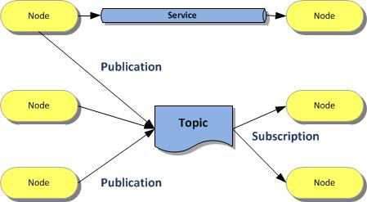
ROS Service

Slide 7
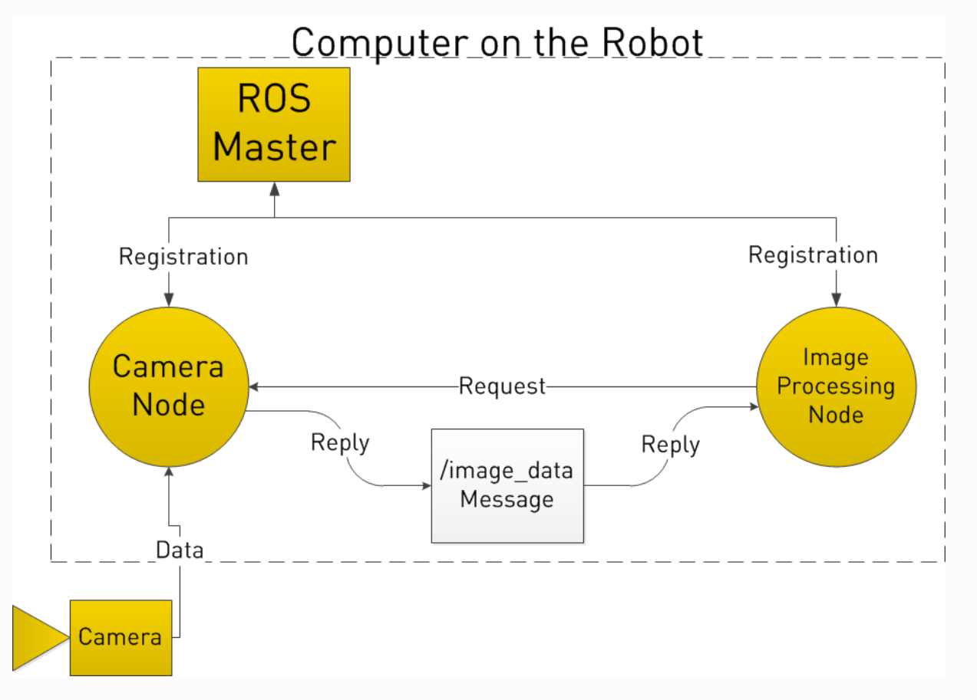
ROS Service
http://www.clearpathrobotics.com/assets/guides/ros/Intro%20to%20the%20Robot%20Operating%20System.html

Slide 8
rosservice command line tool
$ rosservice call /service args: This tool will call the service using the given arguments
$ rosservice find service_type: This command will find services in the given service type
$ rosservice info /service: This will print information about the given service
$ rosservice list: This command will list the active services running on the system
$ rosservice type /service: This command will print the service type of a given service
$ rosservice uri /service: This tool will print the service ROSRPC URI

Slide 9
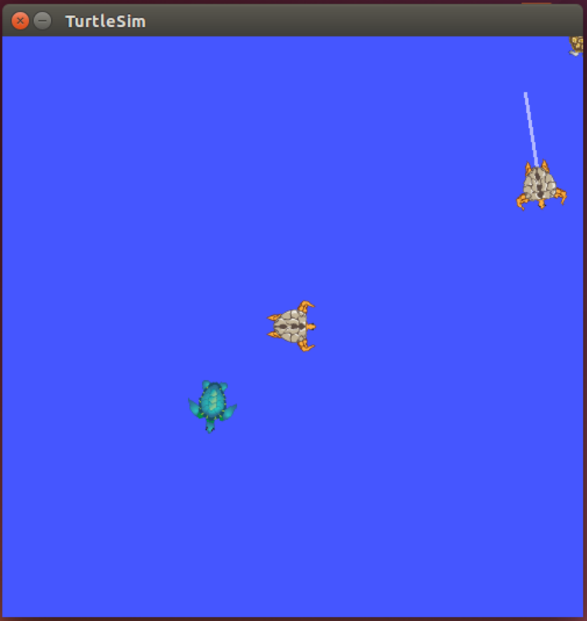
Ros Service Example

Slide 10
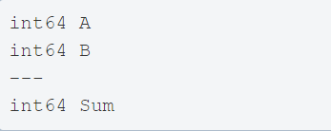
ROS srv
srv: an srv file describes a service. It is composed of two parts: a request and a response.
srv files are just like msg files, except they contain two parts: a request and a response. The two parts are separated by a '---' line. Here is an example of a srv file:
Request
Response

Slide 11
How to create ROS srv?
Defining a Service
Implement the Service
Service Server
Use the service
Service Client

Slide 12
How to define a ROS srv?
It is done in a service definition file
It is .srv file
It is just like message definition files. Maybe just a little bit more compliecated.
It has both input types and output types

Slide 13
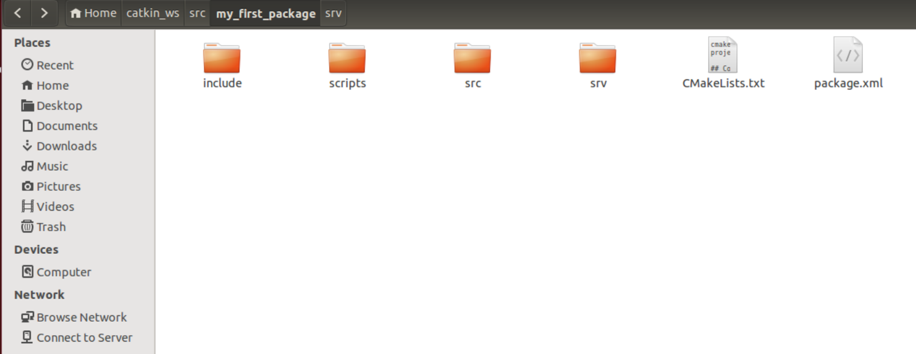
How to define a ROS srv?
It is not a requirement, but traditionally these files are created in srv directory in the main package directory.

Slide 14
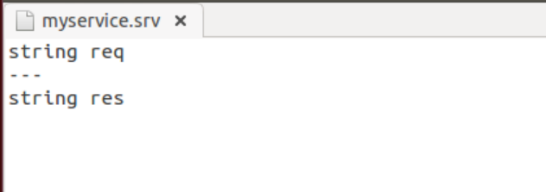
How to define a ROS srv?
There are three dashes between input and output definitions.

Slide 15
How to create ROS srv?
We need to run catkin_make to create the code and class defintions that we will actually use when interacting with services.
In order to get catkin_make build this code, we need to modigy some files.
CMakeList.txt
Package.xml

Slide 16
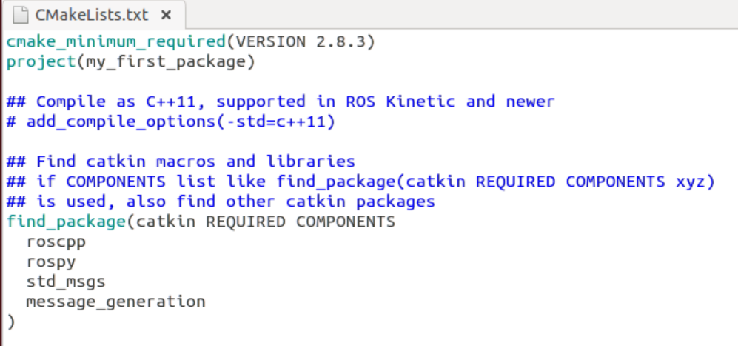
How to create ROS srv?
We need to make sure massage generation package is included.

Slide 17
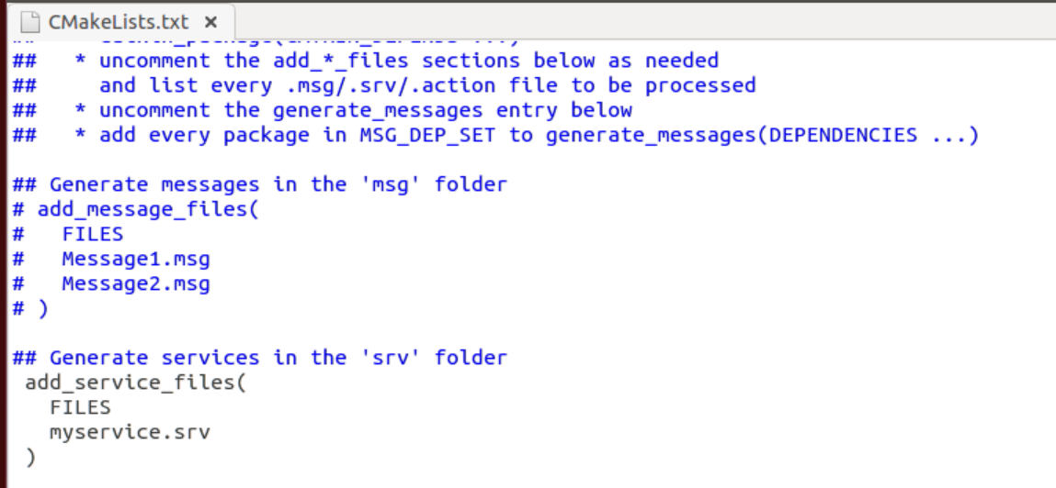
How to create ROS srv?
We need to tell catkin make which service definition files are going to be compiled.

Slide 18
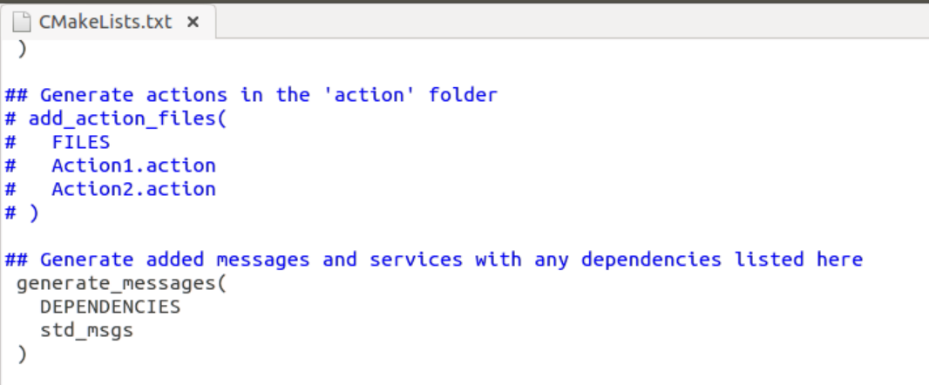
How to create ROS srv?
We must make sure the dependencies for the service definition files is declared.

Slide 19
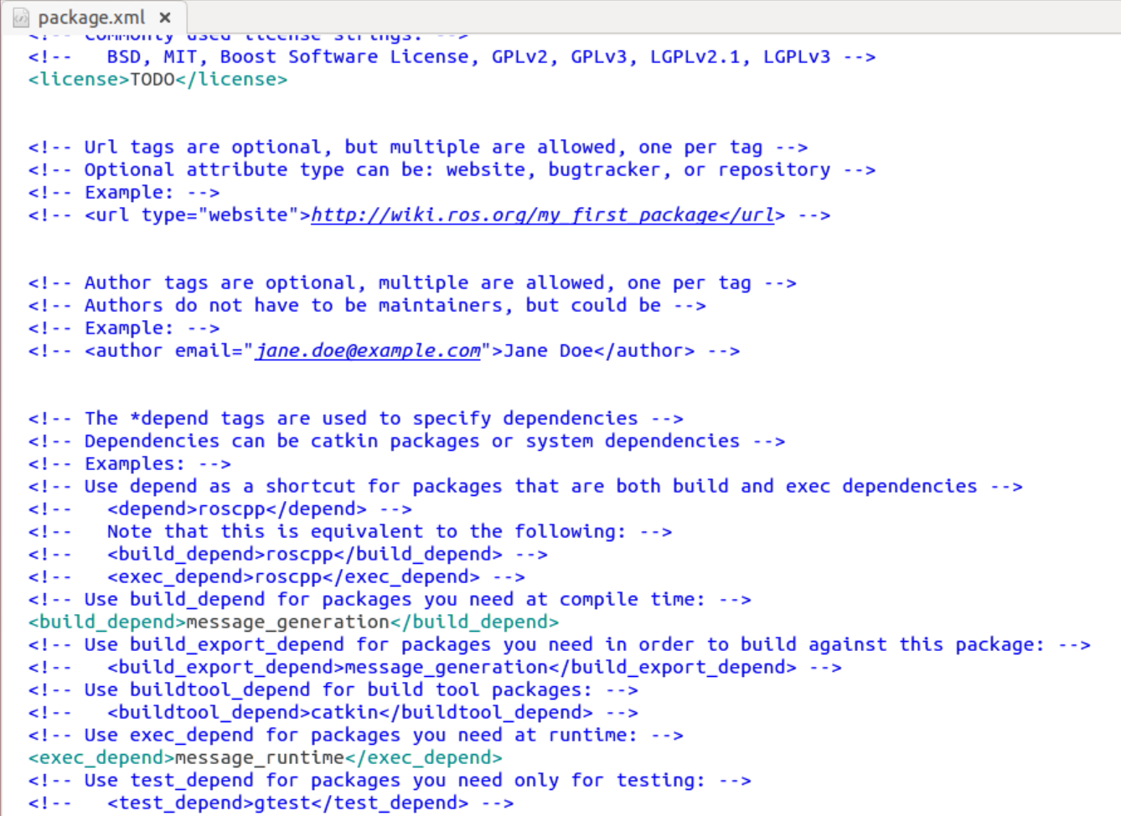
How to create ROS srv?
Our new dependencies on rospy and the message system are needed during build time and runtime.

Slide 20
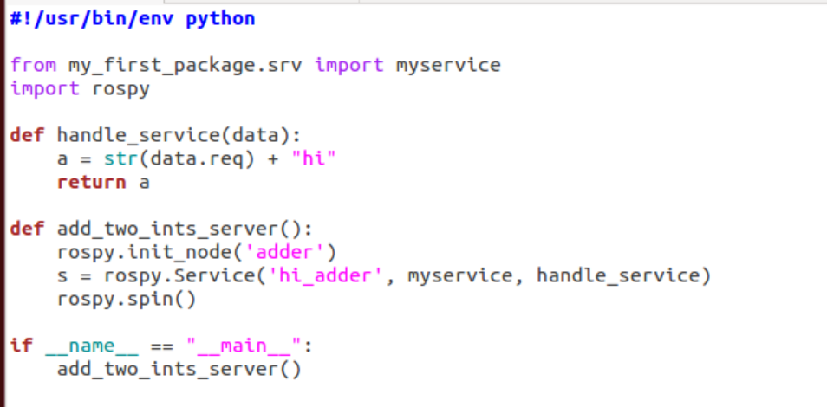
ROS Service Server

Slide 21
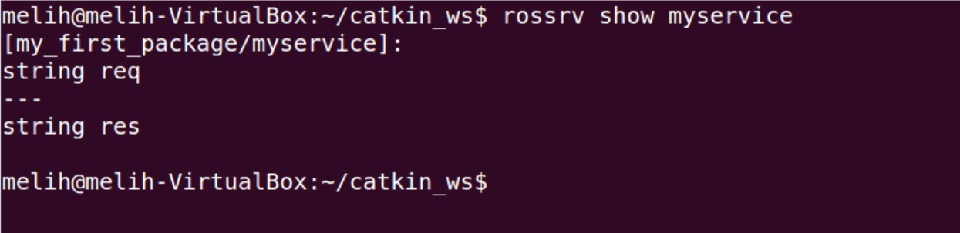
ROS Service Test

Slide 22
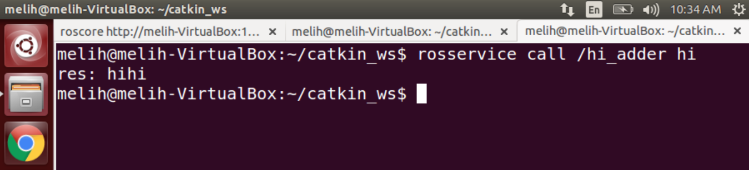
ROS Service Server Test

Slide 23
ROS Service Server Test

Slide 24
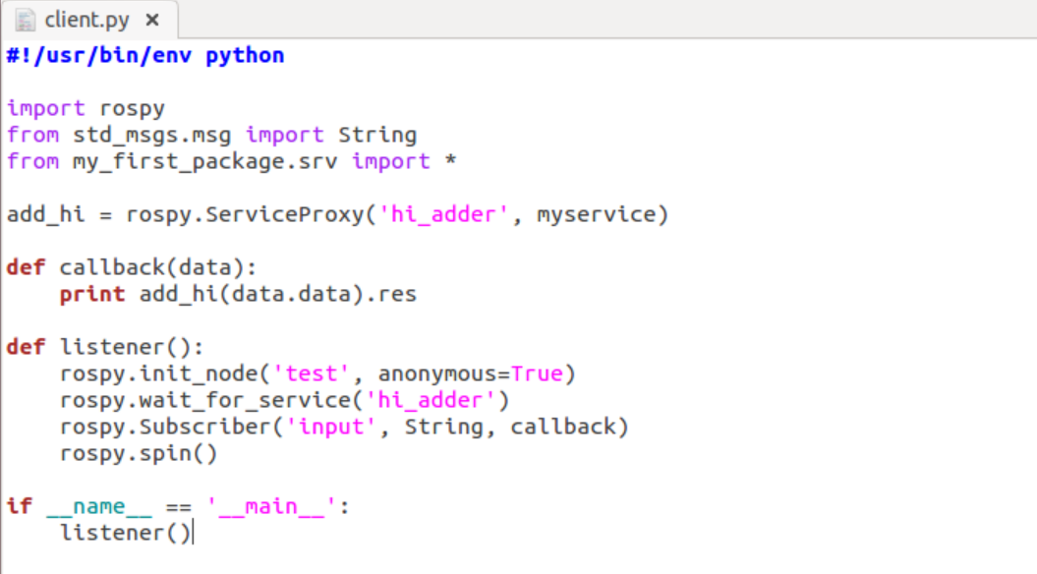
ROS Service Client

Slide 25
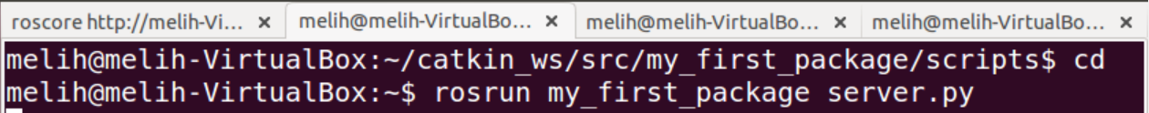
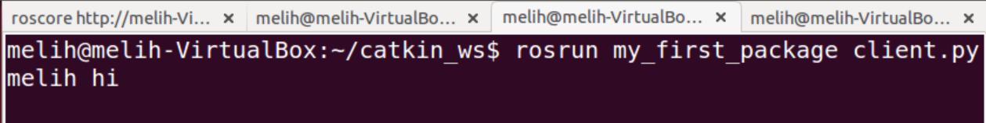
ROS Service Client

Slide 26
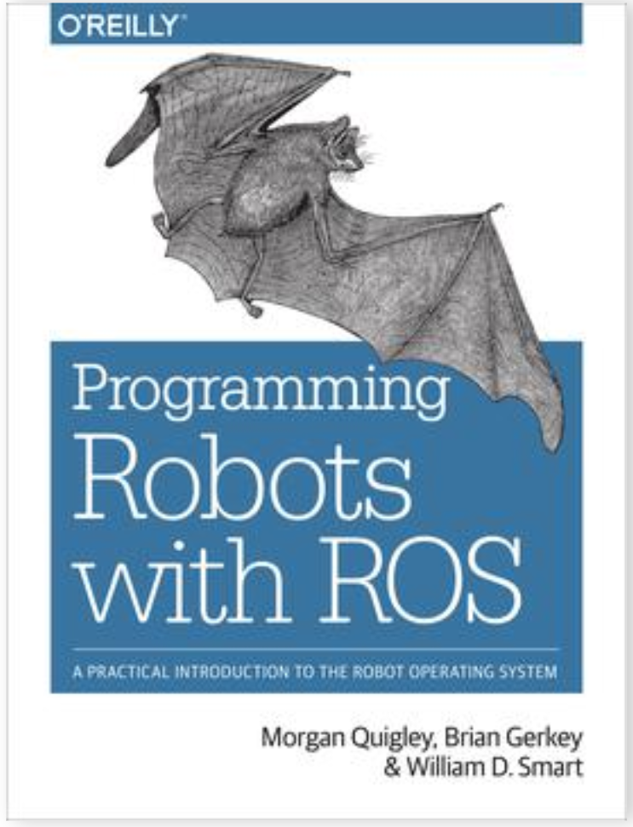
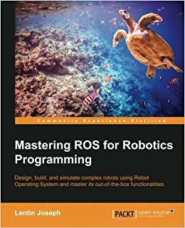

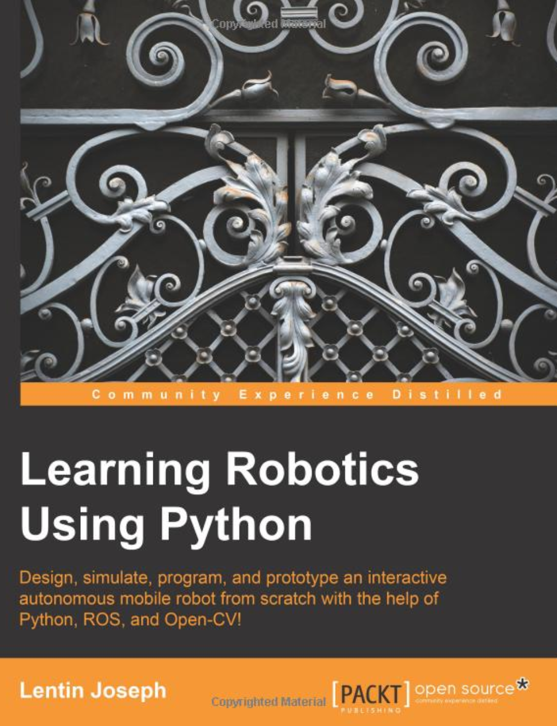
ROS Books

